Slide 1
Camera Pose Estimation from Depth and Point
Tracking
Deboparna Banerjee
116559045
12 Dec 2025
CSE 527 - Introduction to Computer Vision
Supervised by Lei Zhou

Slide 2
Problem Statement
Estimate camera motion and recover a sparse 3D structure from a handheld video.
Use modern feature-tracking and depth models to compute consistent relative poses.
Aim for temporally stable depth, accurate frame-to-frame geometry, and low-drift global trajectories.

Slide 3
Challenges
Point Selection: Identifying which tracked points (dense vs sparse, corner-like vs textured) actually yield stable geometry.
Depth Reliability: Ensuring predicted depth is consistent enough for 3D lifting, despite noise, scale fluctuations, and texture bleeding.
Geometric Consistency: Maintaining stable frame-to-frame poses when noisy correspondences cause PnP instability and drift accumulation.

Slide 4
Methodology
SuperPoint Keypoints: Detect stable corner features as seeds for long-term tracking
CoTracker Tracks: Propagate keypoints (and grid samples) across frames to obtain dense, consistent trajectories
VDA Depth: Predict per-frame metric depth to lift 2D tracks into 3D when translation is present
Shared Correspondences: Extract only tracks visible in both frames for valid 2D–2D and 3D–2D matches
Parallax Check: Measure normalized parallax to classify motion as rotation-only or translational
Rotation-Only Mode: For low parallax, estimate rotation via an Essential matrix + sliding-window averaging; force translation to zero
PnP Translation Mode: For high parallax, use depth + PnP (with RANSAC)
Global Trajectory: Integrate all relative poses into a coherent camera path

Slide 5
PnP Solving
Goal:
Find the camera’s position and orientation using
3D points (from depth) and their 2D locations in the image (from tracking)
Overview:
Each 3D→2D match gives 2 constraints (u,v)
With 3 points, we have enough equations to solve for the 6 unknowns (3 for rotation, 3 for translation)
RANSAC:
Repeatedly picks 3 random correspondences
Computes a candidate pose from those 3 points
All other points “vote” for the pose if their reprojection error is small
The pose with the most votes (inliers) becomes the final camera motion

Slide 6
Trajectory Stitching
We build the full camera path by chaining these relative transforms:
T_{0→k​}=T_{0→1​}T_{1→2​}⋯T_{k−1→k}​
Start at the origin
Apply each new motion on top of the last
The camera’s global position is the cumulative result

Slide 7
Camera Intrinsics from EXIF Metadata
Use ExifTool (by Phil Harvey) to extract camera metadata from iPhone videos
Read focal length, sensor size, and image resolution from EXIF
Convert metadata into the camera intrinsic matrix 𝐾
Intrinsics used for PnP and rotation-only estimation

Slide 8

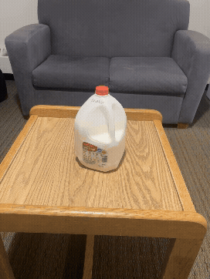
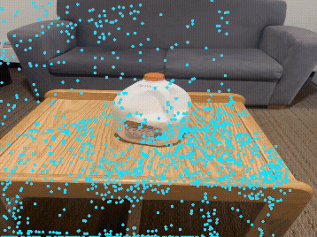
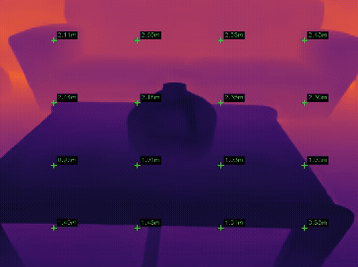
Video Sample 1 - U Shape
Original Video
SuperPoint + Cotracker
Depth Anything

Slide 9
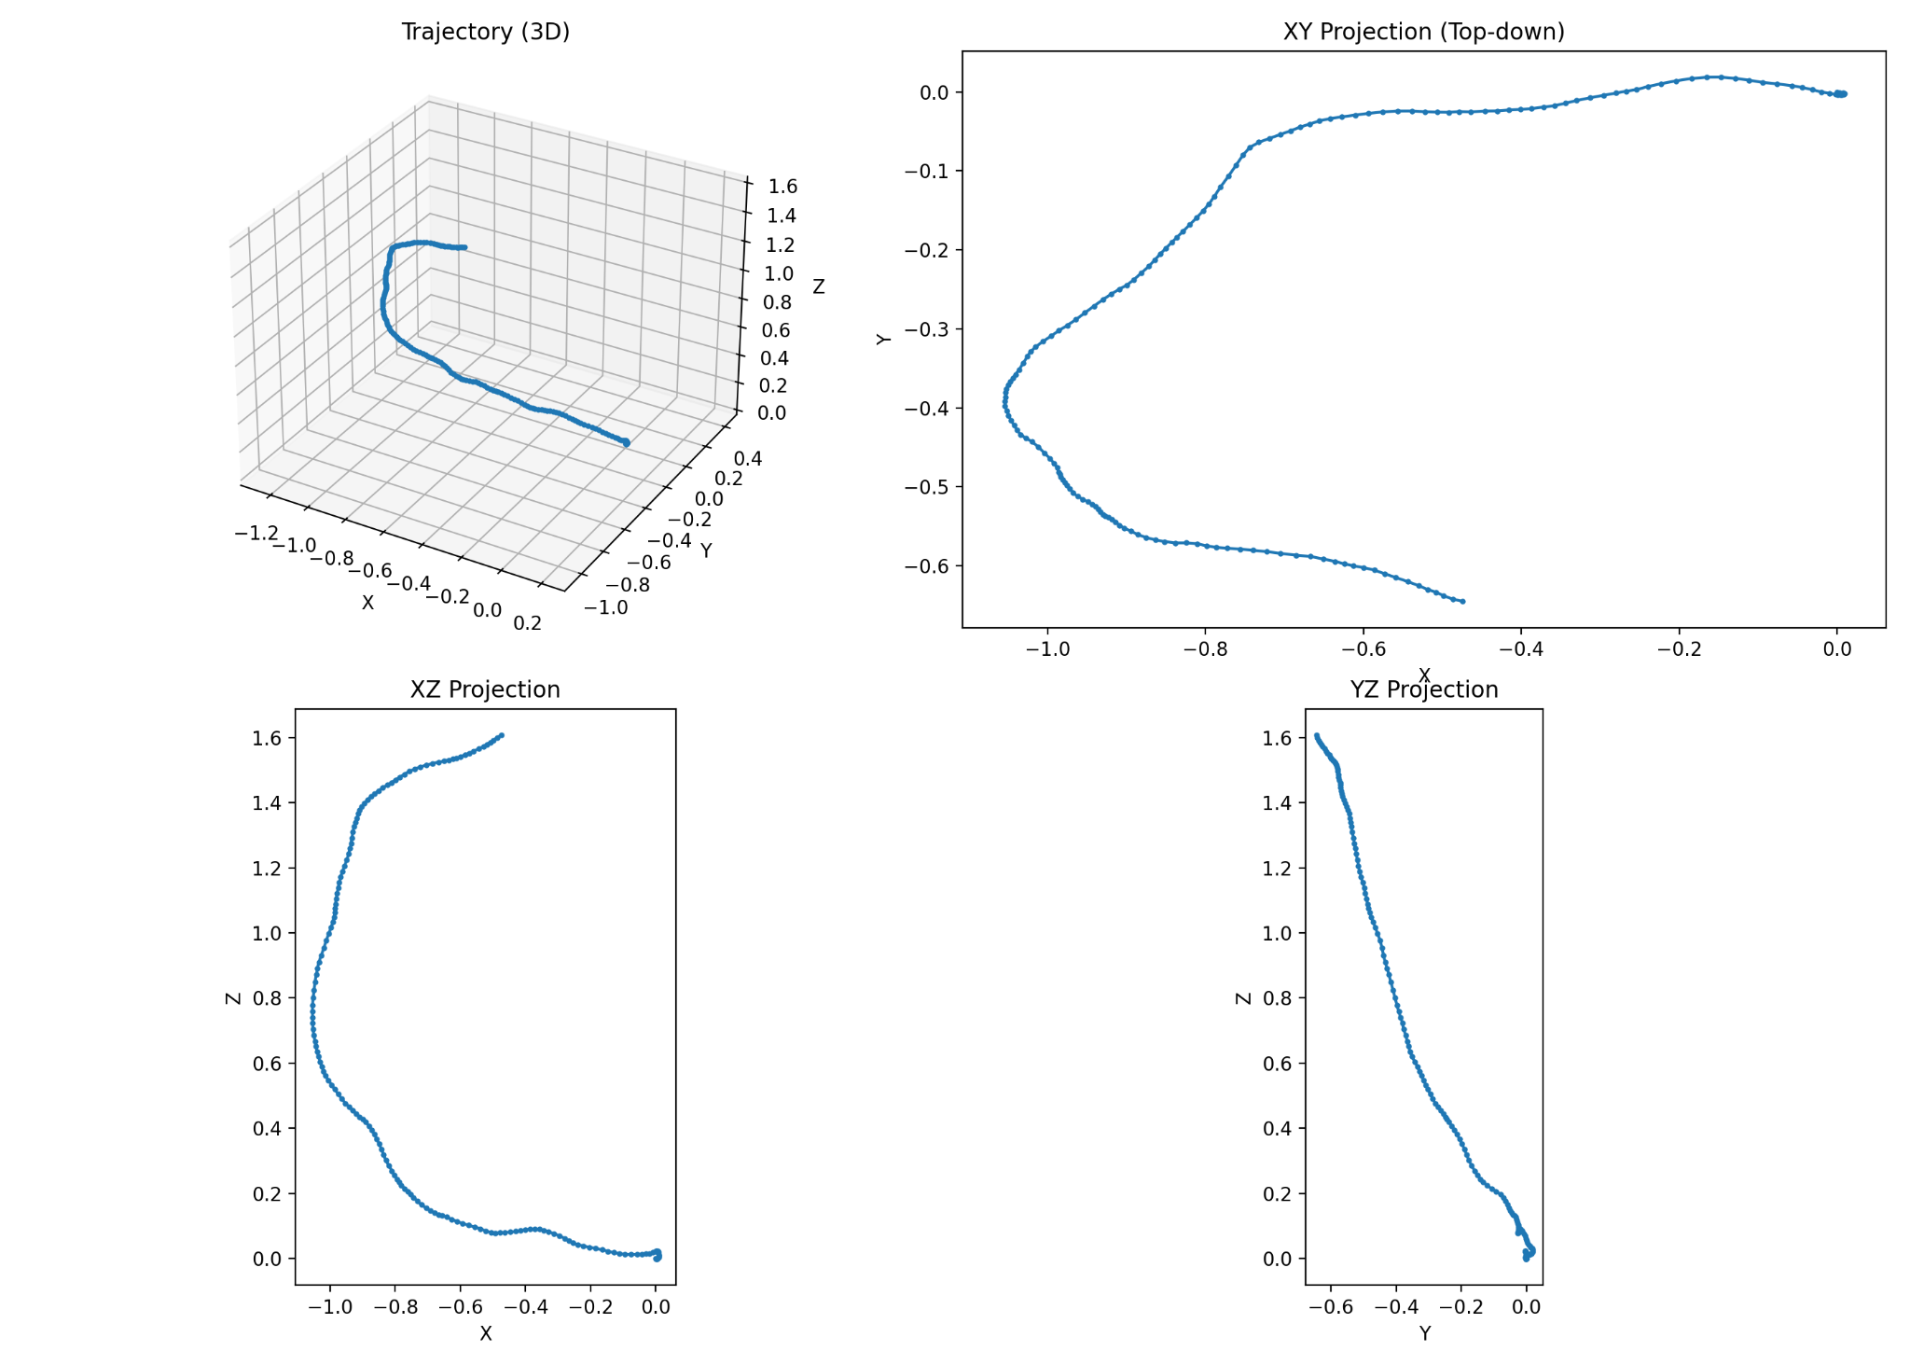
Predicted Trajectory

Slide 10
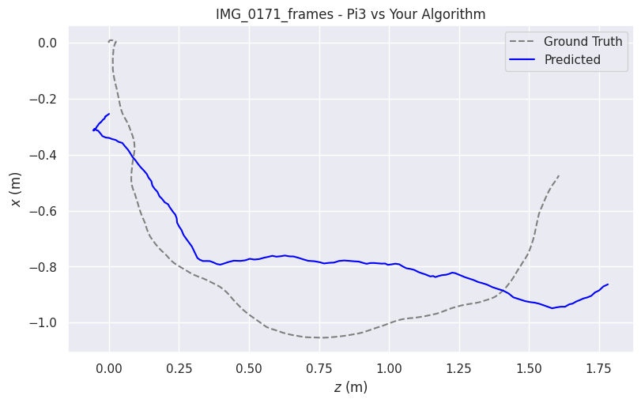
Pi3 Compare
Metric | APE-Trans (m) | RPE-Rot (deg) | RPE-Trans (m)
max | 0.432 | 1.998 | 0.037
mean | 0.199 | 1.286 | 0.021
median | 0.189 | 1.333 | 0.022
min | 0.037 | 0.035 | 0.001
rmse | 0.220 | 1.363 | 0.022
sse | 8.532 | 323.3 | 0.091
std | 0.095 | 0.449 | 0.008
My Trajectory
Pi3 Trajectory

Slide 11
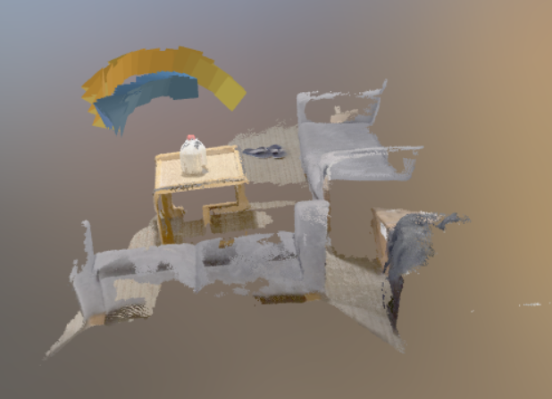
Pi3 Compare
3D Point Cloud

Slide 12
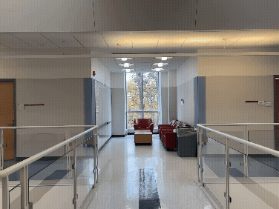
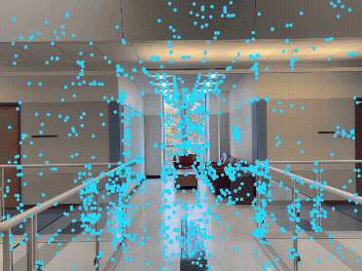
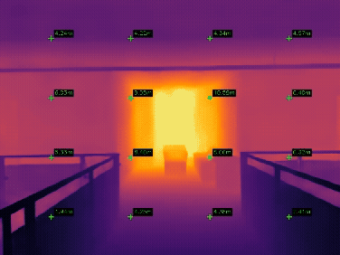
Video Sample 2 - Straight Line
Original Video
SuperPoint + Cotracker
Depth Anything

Slide 13
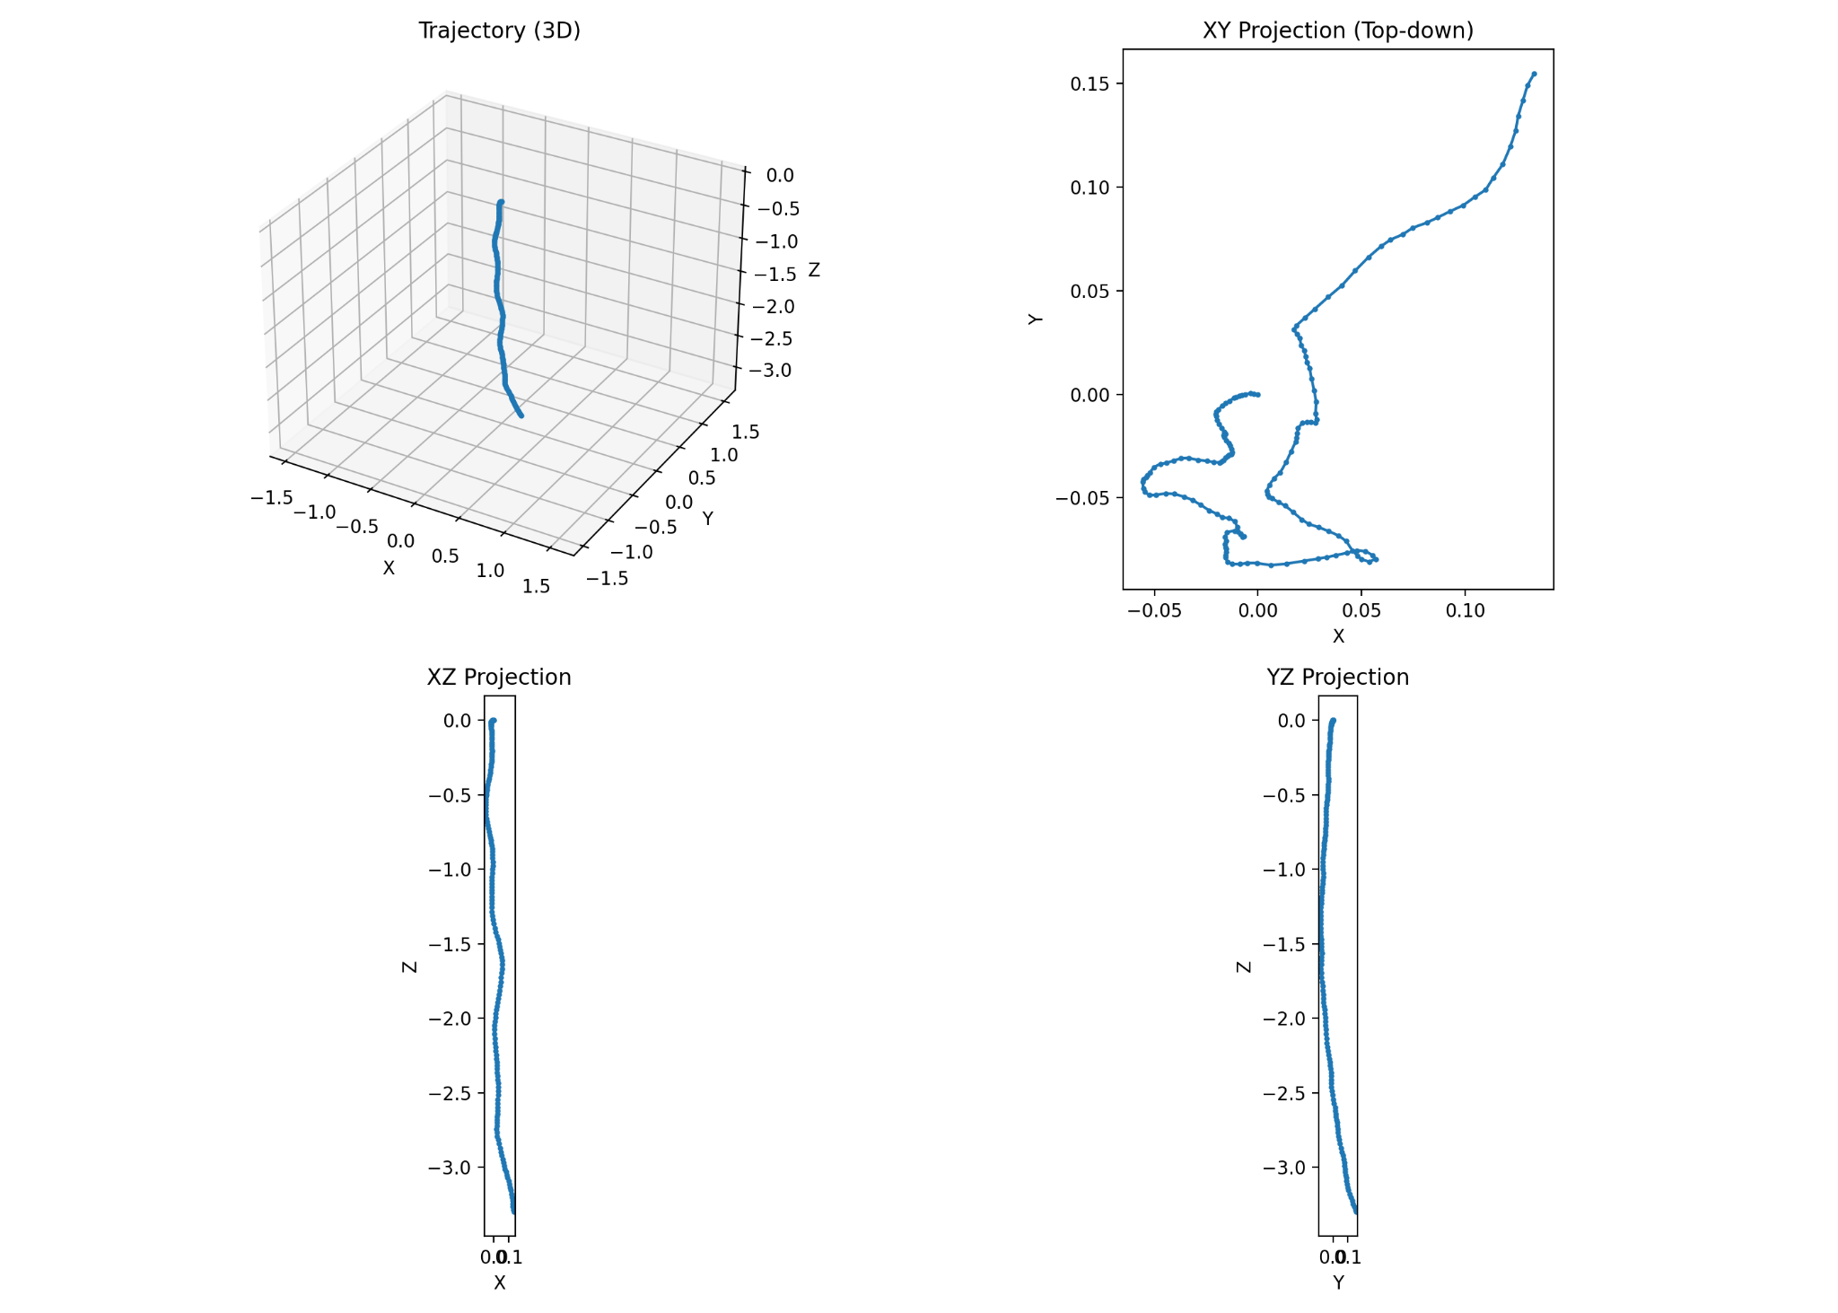
Predicted Trajectory

Slide 14
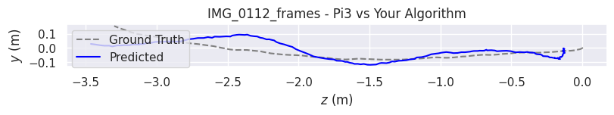
Pi3 Compare
Metric | APE-Trans (m) | RPE-Rot (deg) | RPE-Trans (m)
max | 0.220 | 0.131 | 0.031
mean | 0.078 | 0.060 | 0.011
median | 0.068 | 0.057 | 0.009
min | 0.022 | 0.004 | 0.002
rmse | 0.087 | 0.067 | 0.012
sse | 1.254 | 0.742 | 0.024
std | 0.038 | 0.029 | 0.005
My Trajectory
Pi3 Trajectory

Slide 15
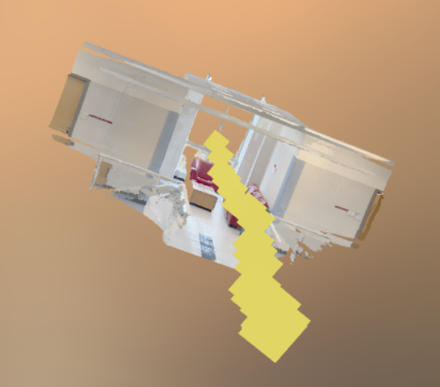
Pi3 Compare
3D Point Cloud

Slide 16
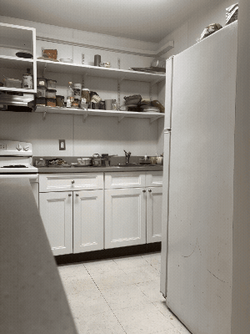
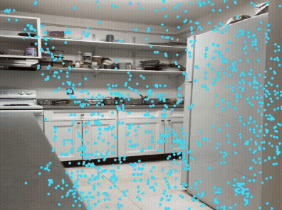
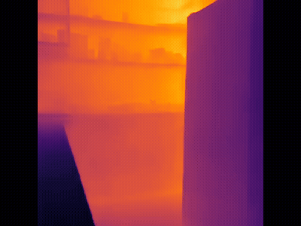
Video Sample 3 - Pure Rotation
Original Video
SuperPoint + Cotracker
Depth Anything

Slide 17
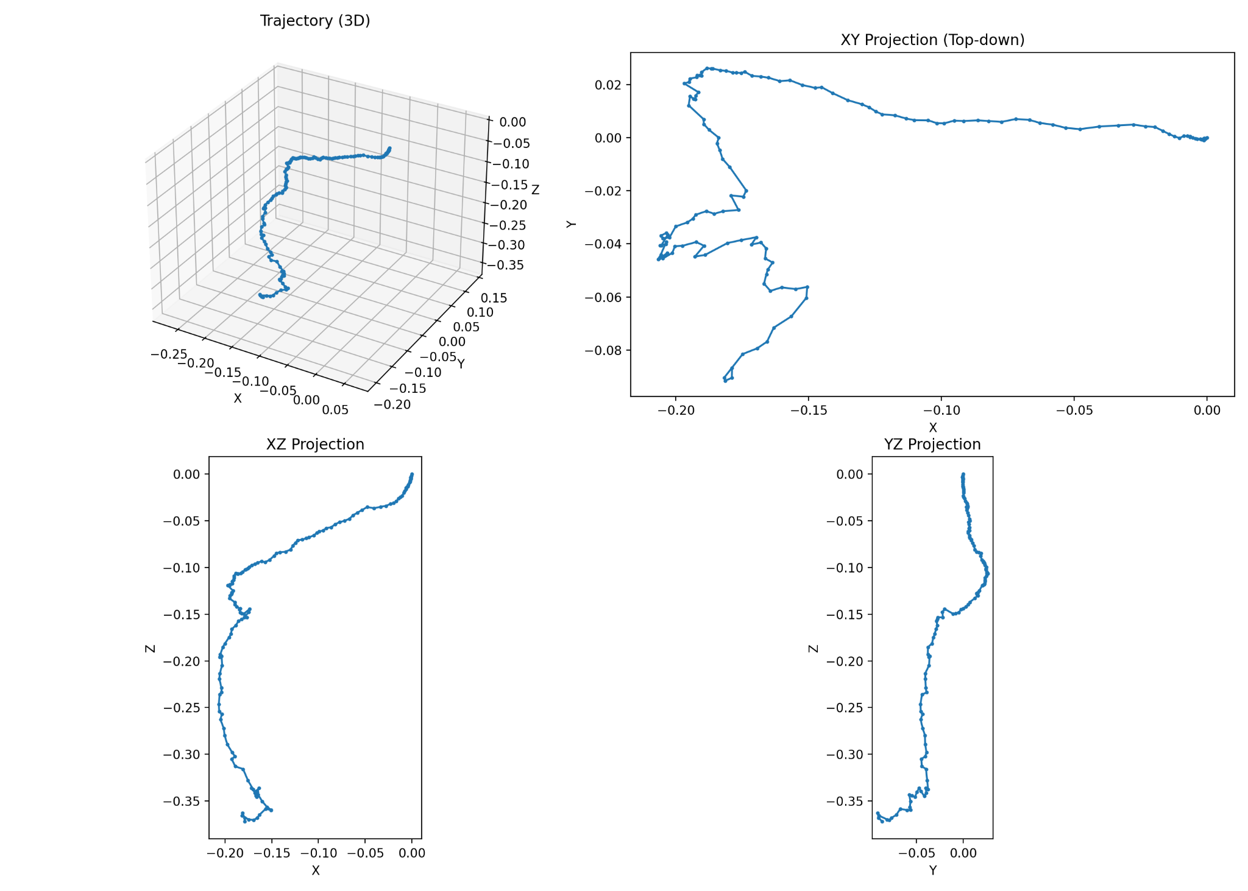
Predicted Trajectory

Slide 18
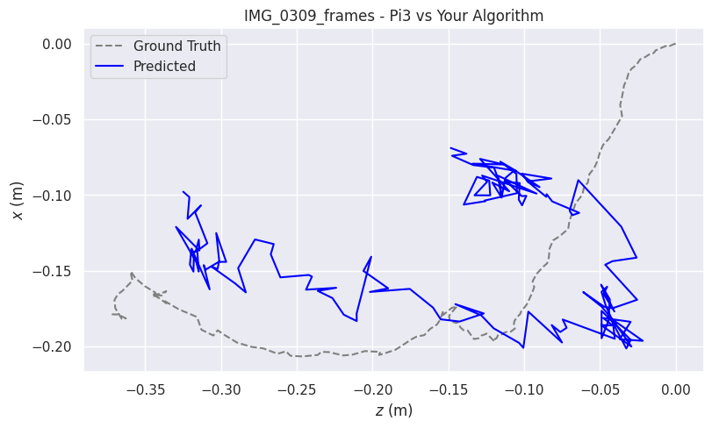
Pi3 Compare
Metric | APE-Trans (m) | RPE-Rot (deg) | RPE-Trans (m)
max | 0.164 | 2.099 | 0.042
mean | 0.071 | 1.178 | 0.016
median | 0.061 | 1.173 | 0.014
min | 0.009 | 0.317 | 0.003
rmse | 0.080 | 1.222 | 0.018
sse | 0.933 | 215.342 | 0.047
std | 0.036 | 0.325 | 0.008
My Trajectory
Pi3 Trajectory

Slide 19
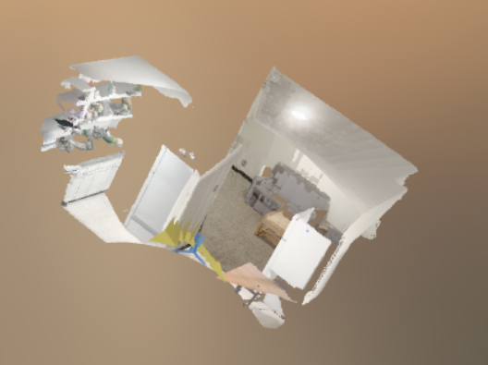
Pi3 Compare
3D Point Cloud

Slide 20
Reasons for Inaccuracies
Frame-to-Frame Drift Accumulation:
Small pose errors compound when chaining transforms
Trajectory slowly bends or drifts from the true path
Pure Rotation Is Fundamentally Ambiguous:
Zero translation ⇒ no parallax
PnP cannot infer translation and introduces small fictitious motion
Depth Noise Propagates Into Geometry:
Local depth fluctuations create slight 3D lifting errors
Leads to mildly inconsistent 3D–2D correspondences and weaker PnP fits
Residual Track Instability Over Time:
SuperPoint + CoTracker + confidence filtering removes most weak tracks
Subtle drift in low-texture or far-off regions still produces rare outliers that influence pose

Slide 21
Future Scope
Global SfM-Based Optimization:
Move beyond pairwise PnP into full structure-from-motion
Better handles low-parallax segments and reduces drift accumulation
Leverage iPhone LiDAR:
Use sparse but accurate LiDAR depth to anchor scale
Reduces 3D lifting ambiguity and stabilizes PnP, especially in low-parallax motion

Slide 22

Thank you!

